Slide 1
The ECG Shoved Under Your Nose

Slide 2
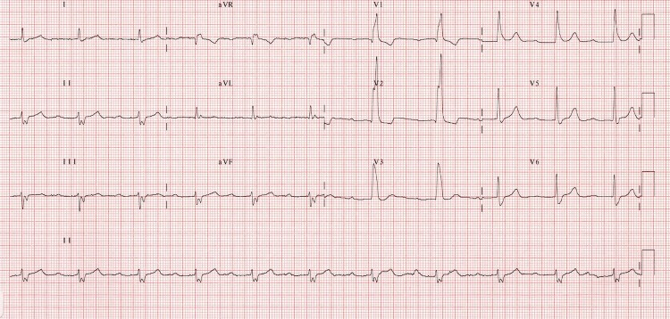
SYNCOPE 67M
Notes:
INCOMPLETE Trifasicular Block – RBBB, LAD, First degree block
High risk pattern esp in patients who are symptomatic/syncopal – likely represents CHB and need for PPM
Incomplete can also be bifasicular with 2nd deg block OR RBBB and alt LAFB/LPFB
COMPLETE TFB is bifasicular with 3RD Deg block
CAUSES
Ischaemic heart disease
Hypertension
Aortic stenosis
Anterior MI
Primary degenerative disease of the conducting system (Lenegre’s / Lev’s disease)
Congenital heart disease
Hyperkalaemia (resolves with treatment)
Digoxin toxicity

Slide 3
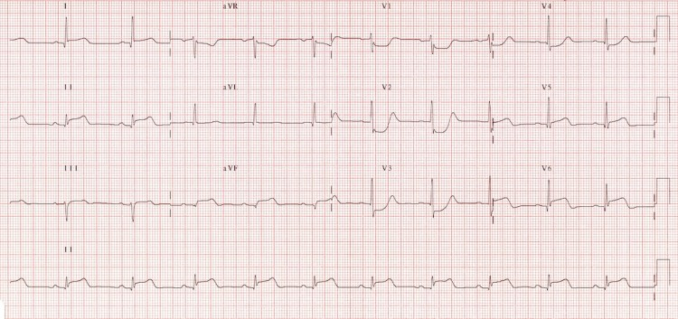
CHEST PAIN 56M
Notes:
Inferolateral STEMI with Posterior extension is suggested by:
Horizontal ST depression in V1-3
Tall, broad R waves (> 30ms) in V2-3
Dominant R wave (R/S ratio > 1) in V2
Upright T waves in V2-3

Slide 4
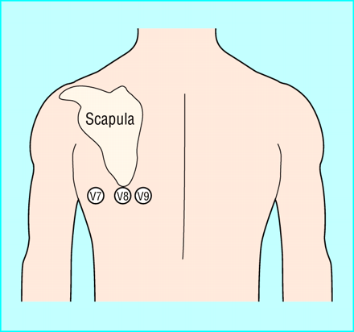
0.5mm
Notes:
Position of Post Leads

Slide 5
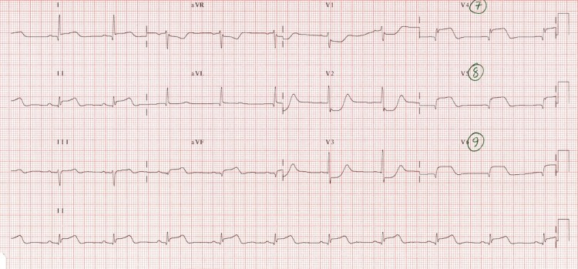
Notes:
Posterior MI on posterior leads
Marked ST elevation in V7-9 with Q-wave formation confirms involvement of the posterior wall, making this an inferior-lateral-posterior STEMI (= big territory infarct!).

Slide 6
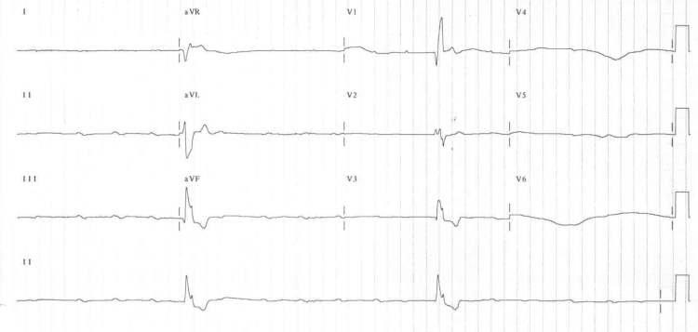
SYNCOPE 67M
Notes:
Complete Heart Block Rate 15
In complete heart block, there is complete absence of AV conduction – none of the supraventricular impulses are conducted to the ventricles.
Perfusing rhythm is maintained by a junctional or ventricular escape rhythm. Alternatively, the patient may suffer ventricular standstill leading to syncope (if self-terminating) or sudden cardiac death (if prolonged).
Typically the patient will have severe bradycardia with independent atrial and ventricular rates, i.e. AV dissociation.
Inferior myocardial infarction
AV-nodal blocking drugs (e.g. calcium-channel blockers, beta-blockers, digoxin)
Idiopathic degeneration of the conducting system (Lenegre’s or Lev’s disease)

Slide 7
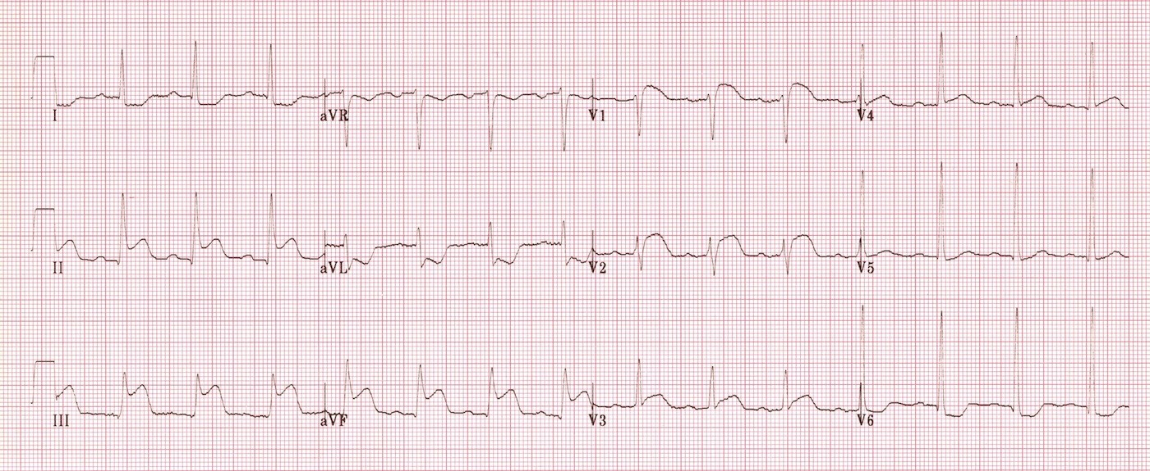
CHEST PAIN 78F
Notes:
RV Infarction
ST elevation in V1 – the only standard ECG lead that looks directly at the right ventricle.
ST elevation in lead III > lead II – because lead III is more “rightward facing” than lead II and hence more sensitive to the injury current produced by the right ventricle.
Other useful tips for spotting right ventricular MI:
ST elevation in V1 > V2.
ST elevation in V1 + ST depression in V2 (= highly specific for RV MI).
Isoelectric ST segment in V1 with marked ST depression in V2.
Inferior STEMI. Right ventricular infarction is suggested by:
ST elevation in V1
ST elevation in lead III > lead II

Slide 8
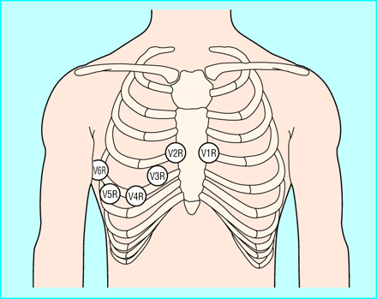
Notes:
RV lead position
Lead V4R is most sensitive and can be moved as a single lead to look for RV infarct

Slide 9
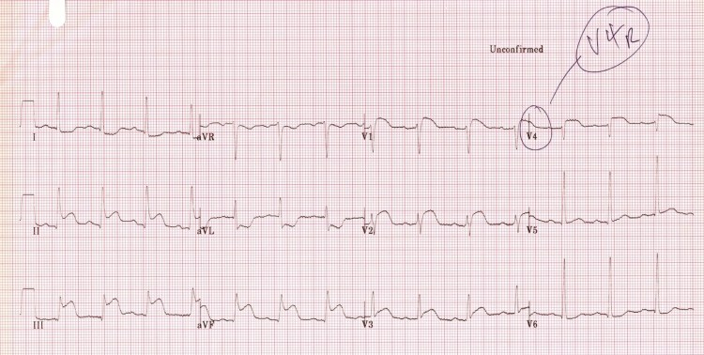
Notes:
RV Infarct on V4R lead

Slide 10
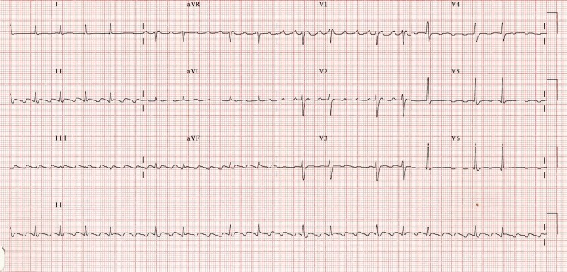
PALPITATIONS, 45M WITH LARGE ETOH INTAKE RECENTLY
Notes:
Atrial flutter
Inverted flutter waves in II, III + aVF with atrial rate ~ 300 bpm
Positive flutter waves in V1 resembling P waves
The degree of AV block varies from 2:1 to 4:1
The diagnosis of flutter with variable block could be inferred here from the R-R intervals alone (e.g. if flutter waves were indistinct) — note how the R-R intervals during periods of 4:1 block are approximately double the R-R intervals during 2:1 block.

Slide 11
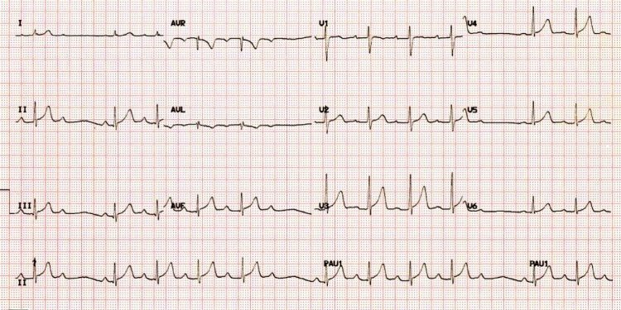
UTI, NOT SURE WHY HAD AN ECG, NO CARDIOVASC SX
Notes:
Wenkeback/Mobitz 1
Lengthening PR then dropped QRS
Greatest change in PR between first and second complexes after the dropped one
If no Sx – usually no Rx required – low rate of progression to a higher grade block
Causes
Drugs: beta-blockers, calcium channel blockers, digoxin, amiodarone
Increased vagal tone (e.g. athletes)
Inferior MI
Myocarditis
Following cardiac surgery (mitral valve repair, Tetralogy of Fallot repair)

Slide 12
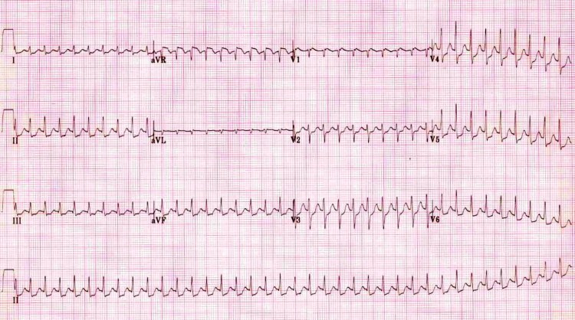
PALPITATIONS 27M
Notes:
AVNRT
Narrow complex tachycardia ~ 220 bpm.
No visible P waves.
Subtle notching of the terminal QRS in V1 (= pseudo R’ wave).
Widespread ST depression — this is a common electrocardiographic finding in AVNRT and does not necessarily indicate myocardial ischaemia, provided the changes resolve once the patient is in sinus rhythm.
Usually AVNRT is a regular tachycardia ~140-280 bpm.
QRS complexes usually narrow (< 120 ms) unless pre-existing bundle branch block, accessory pathway, or rate related aberrant conduction.
ST-segment depression may be seen with or without underlying coronary artery disease.
QRS alternans – phasic variation in QRS amplitude associated with AVNRT and AVRT, distinguished from electrical alternans by a normal QRS amplitude.
P waves if visible exhibit retrograde conduction with P-wave inversion in leads II, III, aVF.
P waves may be buried in the QRS complex, visible after the QRS complex, or very rarely visible before the QRS complex.

Slide 13
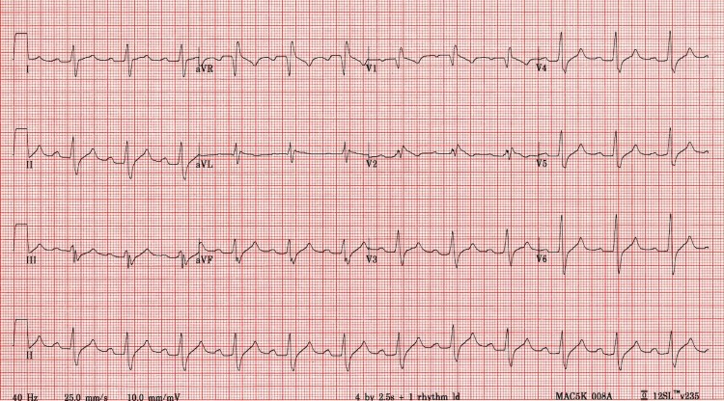
HYPOTENSICE, OBTUNDED, DEPRESSED 17F
Notes:
Propranolol OD (or any Na Ch Blocker like carbemazepine/TCA etc)
1st degree AV block.
Signs of sodium-channel blockade: QRS broadening (> 100 ms) and positive R’ wave in aVR (> 3mm).
QRS 120ms = risk seizures
QRS 160ms – risk vent arrhythmias
DO
Bicarb +++
Fluids
Intubate and hyperventilate
Consider HIET 1 unit/kg actrpid and 50mls 50% dextrose then 0.5-1units/kg/hr of actrapud and 50mls 50% dextrose/hr (titrated to BSL)
Inoropes e.g Nad
ACT EARLY

Slide 14
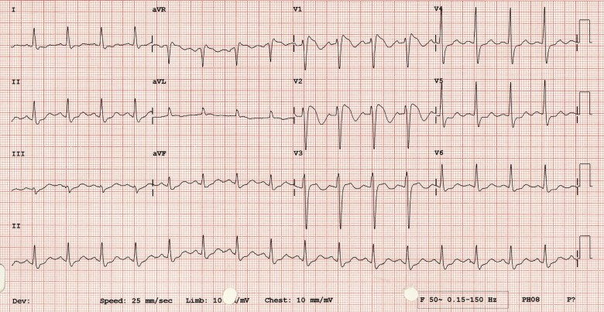
SYNCOPE UNPROVOKES 27M
Notes:
BRUGADA (Type 1 pattern)
There’s really only one type of Brugada syndrome.
Diagnosis depends on a characteristic ECG finding AND clinical criteria.
Further risk stratification is controversial.
Definitive treatment = ICD.
Brugada sign in isolation is of questionable significance.
UNMASKED BY
Fever
Ischaemia
Multiple Drugs
Sodium channel blockers eg: Flecainide, Propafenone
Calcium channel blockers
Alpha agonists
Beta Blockers
Nitrates
Cholinergic stimulation
Cocaine
Alcohol
Hypokalaemia
Hypothermia
Post DC cardioversion

Slide 15
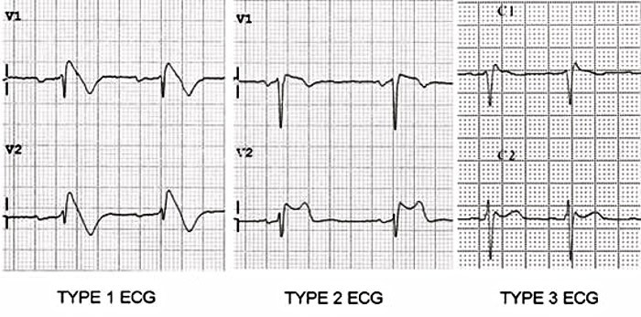
Notes:
BRUGADA
Type 1 (Coved ST segment elevation >2mm in >1 of V1-V3 followed by a negative T wave) is the only ECG abnormality that is potentially diagnostic. This has been referred to as Brugada sign.
Brugada Type 2: has >2mm of saddleback shaped ST elevation.
Brugada type 3: can be the morphology of either type 1 or type 2, but with <2mm of ST segment elevation.

Slide 16
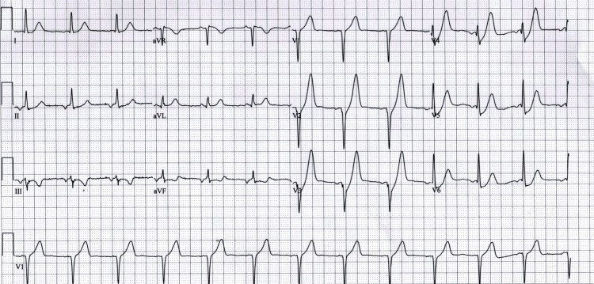
CHEST PAIN, 54M
Notes:
De Winters T’s
Upsloping ST depression in the precordial leads (> 1mm at J-point).
Peaked anterior T waves (V2-6), with the ascending limb of the T wave commencing below the isoelectric baseline.
Subtle ST elevation in aVR > 0.5mm.
The de Winter ECG pattern is an anterior STEMI equivalent that presents without obvious ST segment elevation.
Key diagnostic features include ST depression and peaked T waves in the precordial leads.
The de Winter pattern is seen in ~2% of acute LAD occlusions and is under-recognised by clinicians.
Unfamiliarity with this high-risk ECG pattern may lead to under-treatment (e.g. failure of cath lab activation), with attendant negative effects on morbidity and mortality.

Slide 17
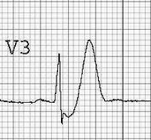

Slide 18
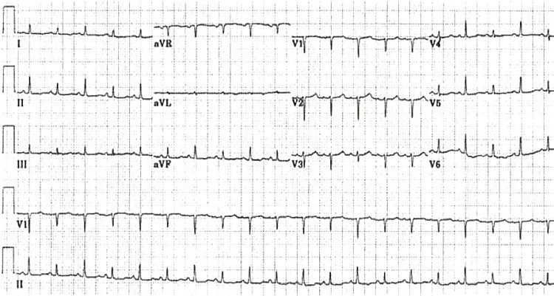
PROGRESSIVE SOB IN NSCLC,hypotensive and shut down 34M
Notes:
ELECTRICAL ALTERNANS
Large pericardial effusion on echo

Slide 19
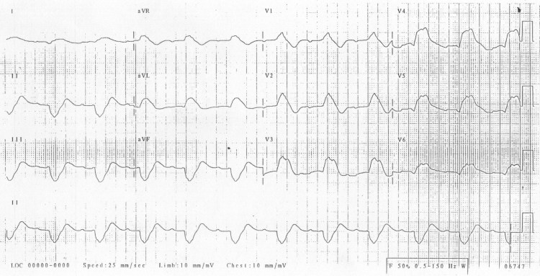
34M CALLED BY REMOTE CLINIC WITH AN ODD ECG – NO LABS AVAILABLE, WHICH DRUGS WILL YOU TELL THEM TO GIVE
Notes:
SEVERE HYPERKALAEMIA/COULD ALSO BE END STAGE NA CHANNEL BLOCKER POISONING
Work in a remote clinic with no point of care testing or labs
Patient is obtunded and cant give any Hx – what 2 drugs will you administer when you see this ECG?
Ca and Bicarb

Slide 20
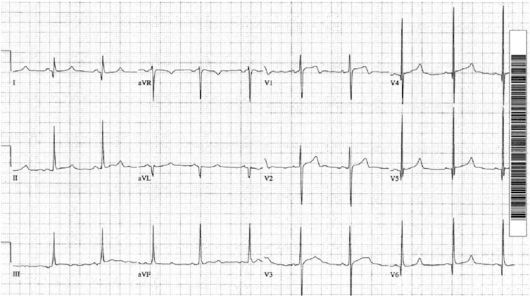
COLLAPSE DURING FOOTY GAME 18M
Notes:
HOCM
Lightheaded on running
Voltage criteria for left ventricular hypertrophy.
Deep narrow Q waves < 40 ms wide in the lateral leads I, aVL and V5-6.
Left atrial enlargement
Left ventricular hypertrophy with associated ST segment / T-wave abnormalities
Deep, narrow (“dagger-like”) Q waves in the lateral > inferior leads
Giant precordial T-wave inversions in apical HCM
Signs of WPW (short PR, delta wave).
Dysrhythmias: atrial fibrillation, supraventricular tachycardias, PACs, PVCs, VT

Slide 21
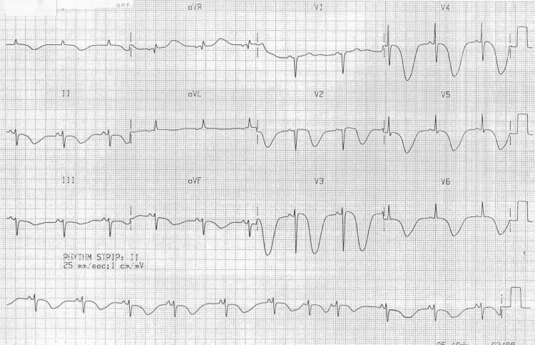
COLLAPSE GCS 4, 47M
Notes:
SAH
Collapse GCS3 ?Cath lab
Widespread, giant T-wave inversions (“cerebral T waves”) secondary to subarachnoid haemorrhage.
The QT interval is also grossly prolonged (600 ms).

Slide 22
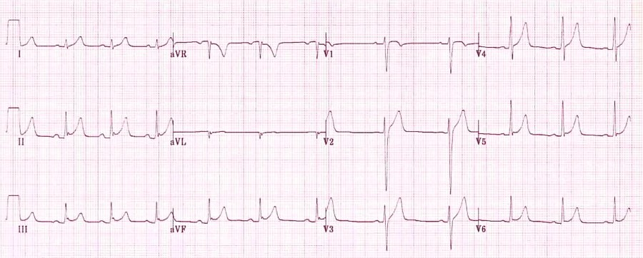
23M Pin point sharp chest pain 20mins, resolved, anxious, H/o PTSD
Notes:
BER
23M Chest pain 20mins, resolved, anxious
Widespread concave ST elevation, most prominent in the mid- to left precordial leads (V2-5).
Notching or slurring at the J-point.
Prominent, slightly asymmetrical T-waves that are concordant with the QRS complexes (pointing in the same direction).
The degree of ST elevation is modest in comparison to the T-wave amplitude (less than 25% of the T wave height in V6)
ST elevation is usually < 2mm in the precordial leads and < 0.5mm in the limb leads, although precordial STE may be up to 5mm in some instances.
No reciprocal ST depression to suggest STEMI (except in aVR).
ST changes are relatively stable over time (no progression on serial ECG tracings).
There is generalised concave ST elevation in the precordial (V2-6) and limb leads (I, II, III, aVF).
J-point notching is evident in the inferior leads (II, III and aVF).
There are prominent, slightly asymmetrical T waves that are concordant with the main vector of the QRS complexes.

Slide 23
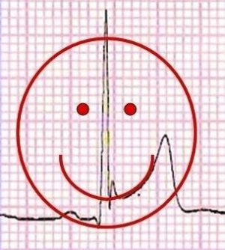
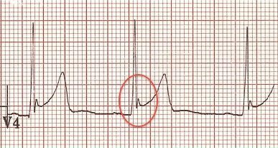
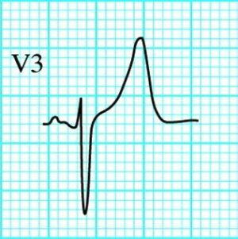
Notes:
Features suggesting BER
ST elevation limited to the precordial leads
Absence of PR depression
Prominent T waves
ST segment / T wave ratio < 0.25
Characteristic “fish-hook” appearance in V4
ECG changes usually stable over time (i.e non-progressive)
Features suggesting pericarditis
Generalised ST elevation
Presence of PR depression
Normal T wave amplitude
ST segment / T wave ratio > 0.25
Absence of “fish hook” appearance in V4
ECG changes evolve slowly over time

Slide 24
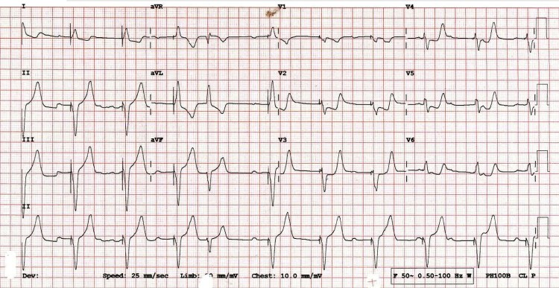
PPM, CHEST PAIN, 67F
Notes:
LBBB/POSITIVE SGARBOSSA
Chest pain -pacemaker in situ – RMO reckon “cant interpret the ST seg because of the CP”
There is concordant ST depression in V2-5 (= Sgarbossa positive).
The morphology in V2-5 is reminiscent of posterior STEMI, with horizontal ST depression and prominent upright T waves.

Slide 25
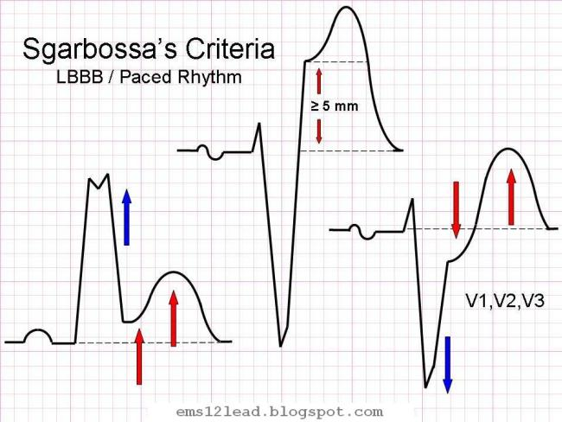
1mm concordant STE/STD
Or
Discordant STE >25% preceeding S
Notes:
Modified Sgarbossa Criteria:
≥ 1 lead with ≥1 mm of concordant ST elevation
≥ 1 lead of V1-V3 with ≥ 1 mm of concordant ST depression
≥ 1 lead anywhere with ≥ 1 mm STE and proportionally excessive discordant STE, as defined by ≥ 25% of the depth of the preceding S-wave.

Slide 26
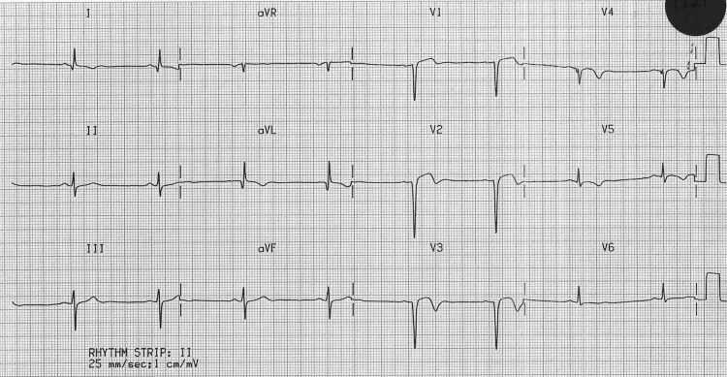
Notes:
LV Aneurism
Sent in by GP – “?another STEMI”, had palpitations/anxiety. No CP
STEMI 4 weeks ago
ST elevation seen > 2 weeks following an acute myocardial infarction.
Most commonly seen in the precordial leads.
May exhibit concave or convex morphology.
Usually associated with well-formed Q- or QS waves.
T-waves have a relatively small amplitude in comparison to the QRS complex (unlike the hyperacute T-waves of acute STEMI).

Slide 27
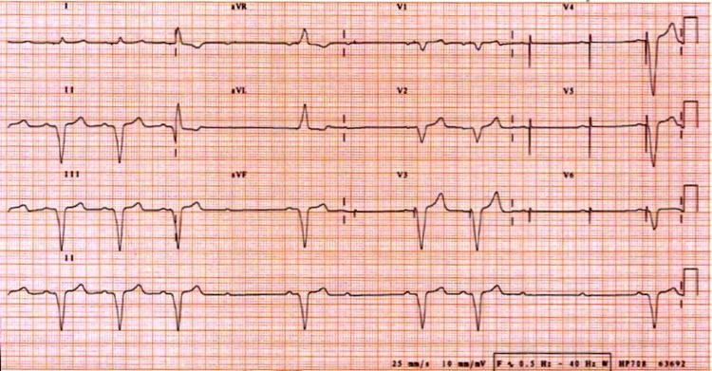
SYNCOPE/PALPITATIONS 67F
Notes:
FAILURE OF PACING
Atrial sensing appears to be intact — ventricular pacing spikes follow each P wave, most easily seen in V3-6 (tiny pacing spikes are also visible in I, aVR and V1).
There is presumably an underlying complete heart block or high-grade 2nd degree AV block, as the native P waves do not capture the ventricles.

Slide 28
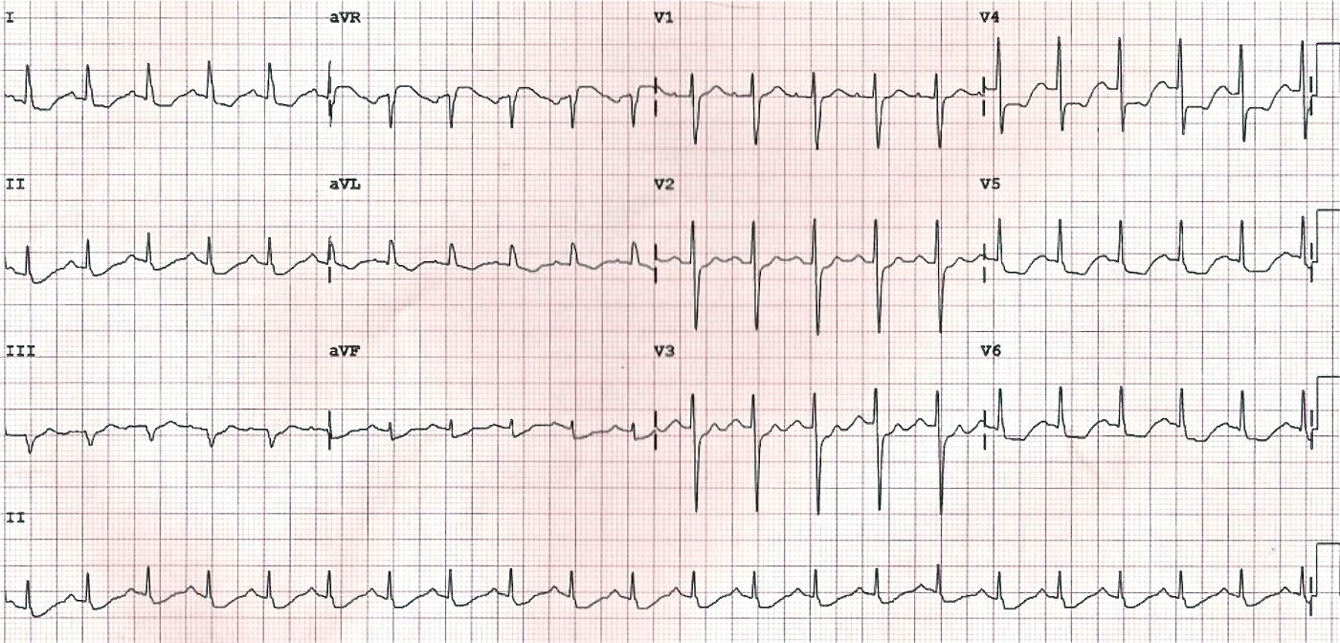
CARDIAC SOUNDING CHEST PAIN, RMO CANT FIND ANY CRITERIA TO THROMBOLYSE, 56M
Notes:
LMCO
Widespread horizontal ST depression, most prominent in leads I, II and V4-6
ST elevation in aVR ≥ 1mm
ST elevation in aVR ≥ V1
ST Elevation in aVR may also be seen with:
Proximal left anterior descending artery (LAD) occlusion
Severe triple-vessel disease (3VD)
Diffuse subendocardial ischaemia – e.g. due to O2 supply/demand mismatch, following resuscitation from cardiac arrest
STE in aVR ≥ 0.5mm was associated with a 4-fold increase in mortality
STE in aVR ≥ 1mm was associated with a 6- to 7-fold increase in mortality
STE in aVR ≥ 1.5mm has been associated with mortalities ranging from 20-75%

Slide 29
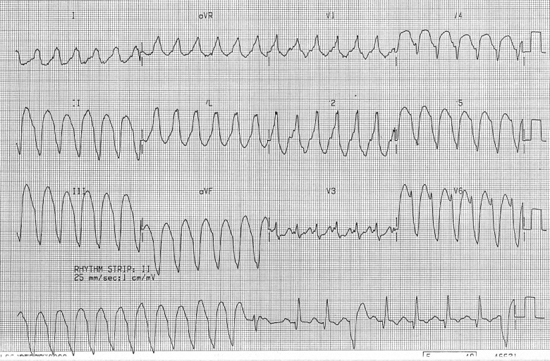
COLLAPSE, HYPOTENSION 56F
Notes:
VT MONOMORPHIC
Very broad QRS complexes (~ 200 ms) with uniform morphology.
Fusion and capture beats are seen in the rhythm strip.
Brugada’s sign is present: the time from the onset of the QRS complex to nadir of S wave is > 100 ms (best seen in V6).
Features suggestive of VT
Very broad complexes (>160ms).
Absence of typical RBBB or LBBB morphology.
Extreme axis deviation (“northwest axis”) — QRS is positive in aVR and negative in I + aVF.
AV dissociation (P and QRS complexes at different rates).
Capture beats — occur when the sinoatrial node transiently ‘captures’ the ventricles, in the midst of AV dissociation, to produce a QRS complex of normal duration.
Fusion beats — occur when a sinus and ventricular beat coincide to produce a hybrid complex of intermediate morphology.
Positive or negative concordance throughout the chest leads, i.e. leads V1-6 show entirely positive (R) or entirely negative (QS) complexes, with no RS complexes seen.
Brugada’s sign – The distance from the onset of the QRS complex to the nadir of the S-wave is > 100ms.
Josephson’s sign – Notching near the nadir of the S-wave.
RSR’ complexes with a taller “left rabbit ear”. This is the most specific finding in favour of VT. This is in contrast to RBBB, where the right rabbit ear is taller.

Slide 30
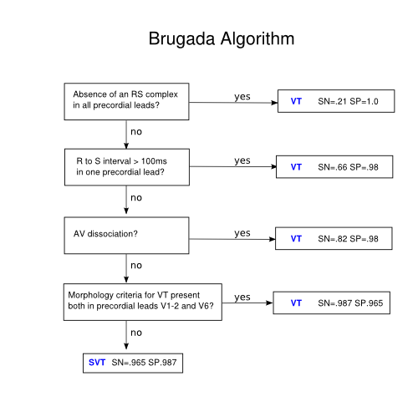

Slide 31
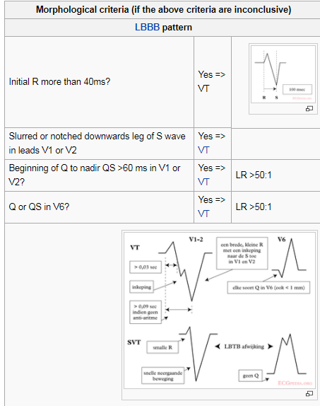
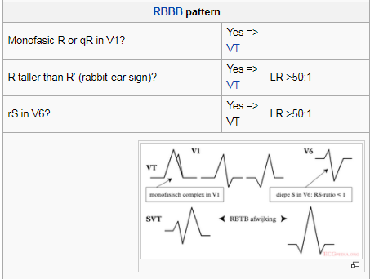

Slide 32
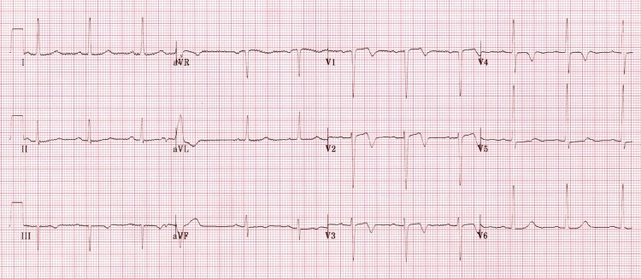
RESOLVED CHEST PAIN, 65F
Notes:
WELLEN’S
Deeply-inverted or biphasic T waves in V2-3 (may extend to V1-6)
Isoelectric or minimally-elevated ST segment (< 1mm)
No precordial Q waves
Preserved precordial R wave progression
Recent history of angina
ECG pattern present in pain-free state
Normal or slightly elevated serum cardiac markers

Slide 33
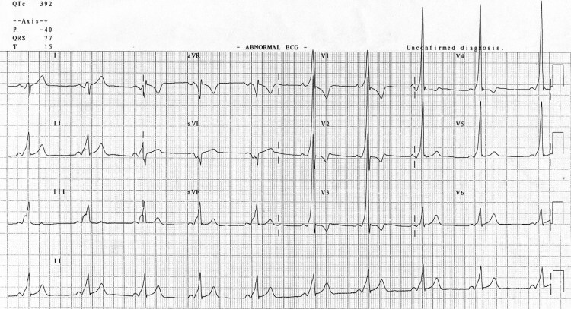
ROUTINE PRE-OP ECG 45M
Notes:
WPW
Sinus rhythm with a very short PR interval (< 120 ms).
Broad QRS complexes with a slurred upstroke to the QRS complex — the delta wave.
Dominant R wave in V1 — this pattern is known as “Type A” WPW and is associated with a left-sided accessory pathway.
Tall R waves and inverted T waves in V1-3 mimicking right ventricular hypertrophy — these changes are due to WPW and do not indicate underlying RVH.
Negative delta wave in aVL simulating the Q waves of lateral infarction — this is referred to as the “pseudo-infarction” pattern.

Slide 34
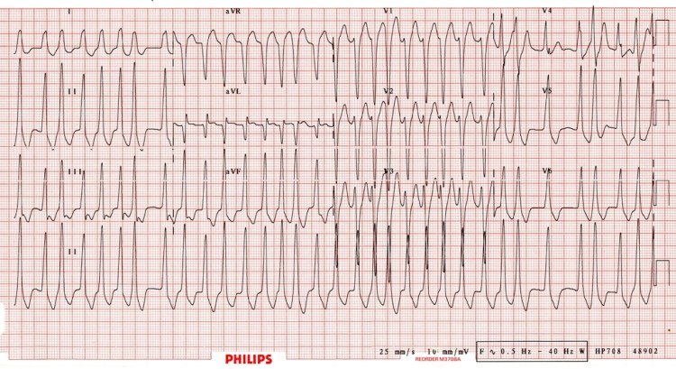
PALPITATIONS THEN COLLAPSE, BP 90/70, 48M
Notes:
AF WPW
Known WPW – palpitations – Reg drawing up Adenosine
Rapid, irregular, broad complex tachycardia (overall rate ~ 200 bpm) with a LBBB morphology (dominant S wave in V1).
This could easily be mistaken for AF with LBBB.
However, the morphology is not typical of LBBB, the rate is too rapid (up to 300 bpm in places, i.e. too rapid to be conducted via the AV node) and there is a subtle beat-to-beat variation in the QRS width which is more typical of WPW (LBBB usually has fixed width QRS complexes).

Slide 35
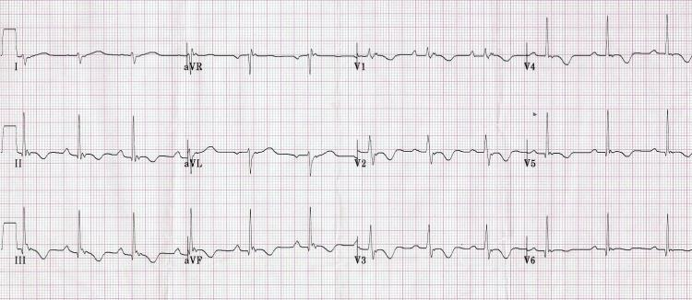
COLLAPE X4 IN 1 MONTH, 23M
Notes:
ARVD
Epsilon wave (most specific finding, seen in 30% of patients)
T wave inversions in V1-3 (85% of patients)
Prolonged S-wave upstroke of 55ms in V1-3 (95% of patients)
Localised QRS widening of 110ms in V1-3
Paroxysmal episodes of ventricular tachycardia with LBBB morphology (e.g. right ventricular VT).
An inherited myocardial disease associated with paroxysmal ventricular arrhythmias and sudden cardiac death.
Characterized pathologically by fibro-fatty replacement of the right ventricular myocardium.
The second most common cause of sudden cardiac death in young people (after HOCM), causing up to 20% of sudden cardiac deaths in patients < 35 yrs of age.
Typically inherited as an autosomal dominant trait, with variable penetrance and expression (there is an autosomal recessive form called Naxos Disease, which is associated with woolly hair and skin changes).
More common in men than women (3:1) and in people of Italian or Greek descent.
Estimated to affect approximately 1 in 5,000 people overall.

Slide 36
Notes:
Epsilon Wave

