Slide 1
Acid Base
AMAZINGNESS
Niall Kennedy

Slide 3
RULES
Numbers are your friend
Equations are there to help you
The body will always try to correct the abnormality…but some annoying things get in the way!
THERE IS NO SUCH THING AS OVER-CORRECTING

Slide 4
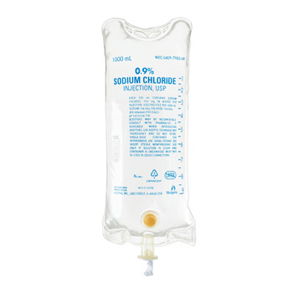
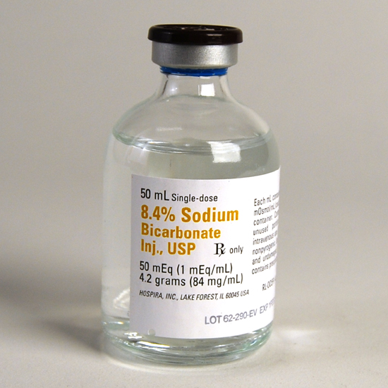
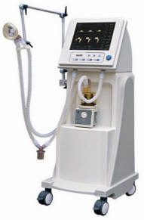

Slide 6
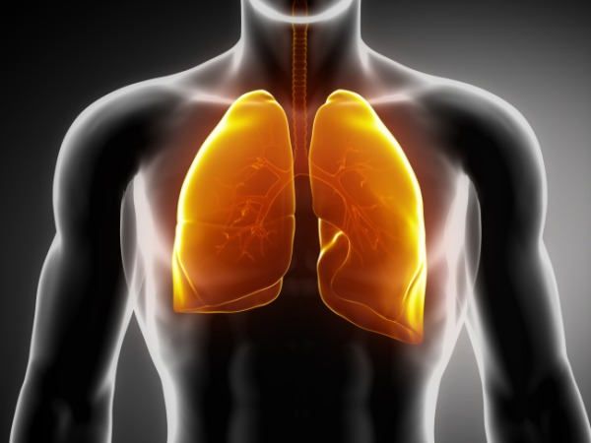
Respiratory Stuff
All about the change in PaCO2
1, 2, (HCO3) 4, 5.

Slide 7
Respiratory Stuff
ALL ABOUT HOW CO2 AFFECTS HCO3
CHANGE MEASURED FOR EVERY 10mmHg CO2
Respiratory Acidosis 1 (acute) -> 4 (chronic)
Respiratory Alkalosis 2 (acute) -> 5 (chronic)

Slide 8
Acute
Chronic
Resp
ACID
Resp
ALK
Resp
ACID
Resp
ALK
1
2
HCO3
4
5

Slide 9
Winter’s Formula
Expected CO2 in Metabolic Acidosis

Slide 10
Anion Gap
AG = (Na + K) - (Cl + HCO3)
NORMAL = 12 to 16

Slide 11
Anion Gap
CORRECT
“4”
Hypo-ALBUMINAEMIA
Albumin is a huge buffer protein that mops up anions
Corrected = AG + [(44 - albumin)/4]

Slide 12
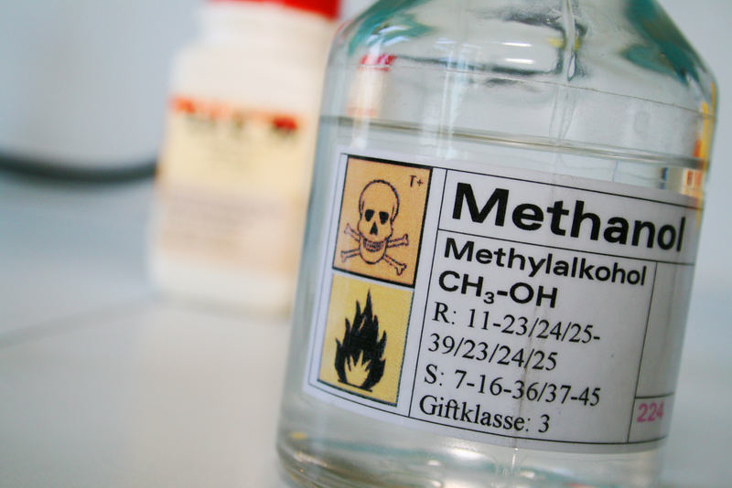
Osmolar Gap
Calculated Osm = 2[Na] + [Urea] + [Glucose] +
GAP = Measured - Calculated
Should be
<20 mOsm/kg

Slide 13
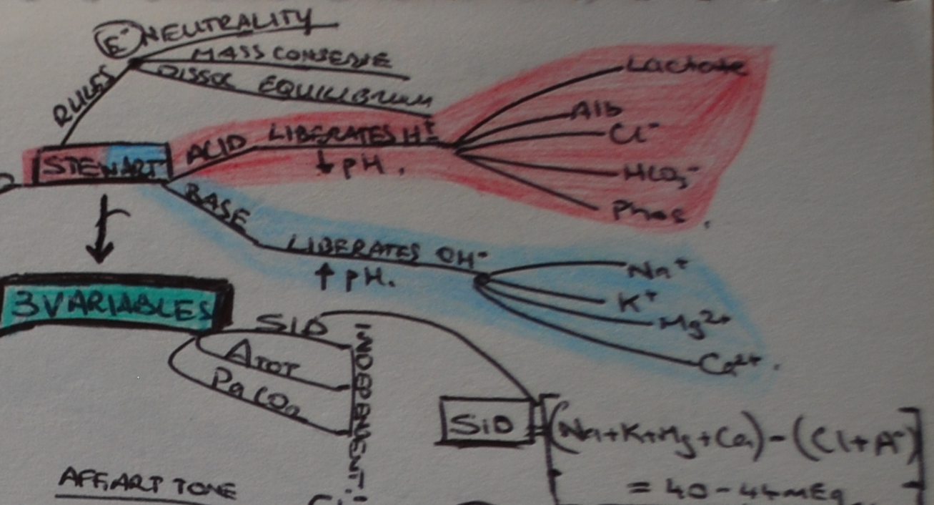

Slide 14
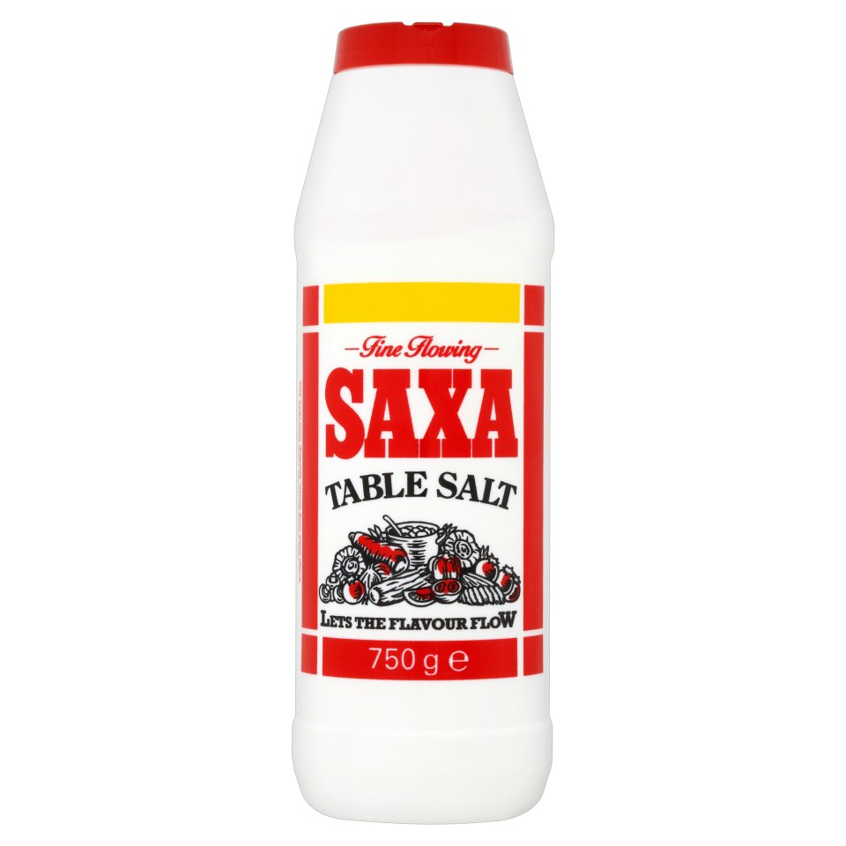
Na : Cl
1.4 : 1

Slide 16
Metabolic Alkalosis
Expected PaCO2 = 0.7 [HCO3] + 20
or
0.6 [HCO3] + 40
or
0.9 [HCO3] + 15
Pick one that works for your brain!

Slide 17
Case 1
55 year old male with OSAHS and daytime somnolence.
Interpret ABG

Slide 18
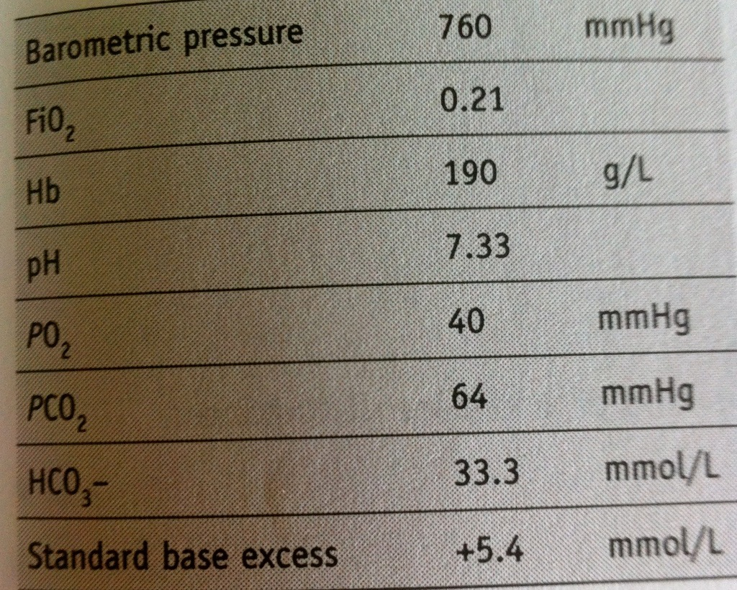

Slide 19
Respiratory Stuff
All about the change in PaCO2
1, 2, (HCO3) 4, 5.

Slide 20
Acute
Chronic
Resp
ACID
Resp
ALK
Resp
ACID
Resp
ALK
1
2
HCO3
4
5

Slide 22
Case 1
Chronic respiratory acidosis with metabolic compensation

Slide 23
Case 2
A female is pulled unconscious from her house by firemen after falling asleep smoking.
She has minor superficial burns to her face.
Interpret ABG

Slide 24
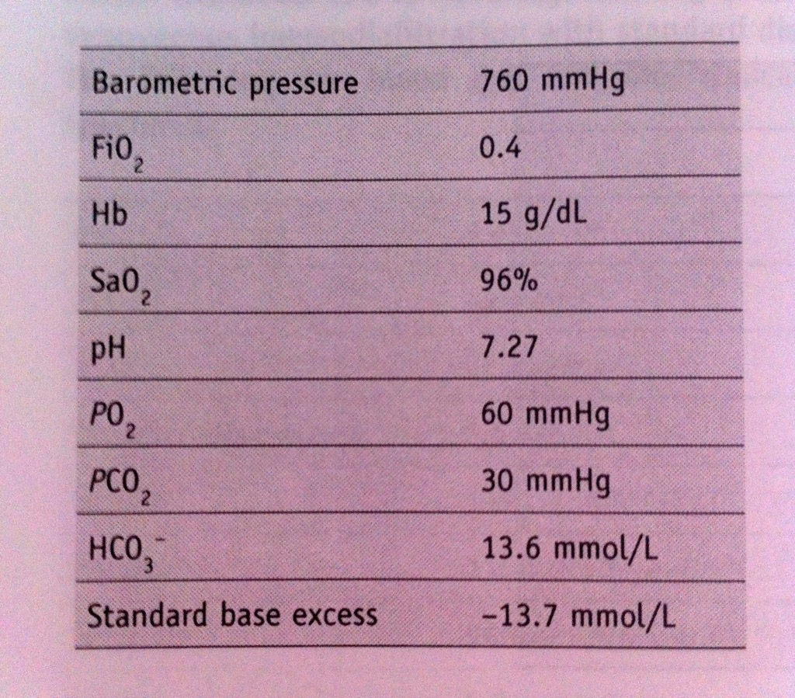

Slide 25
Case 2
Metabolic acidosis with respiratory compensation
Likely diagnoses include; inhalational injury, CO poisoning, lactic acidosis, possible cyanide poisoning

Slide 26
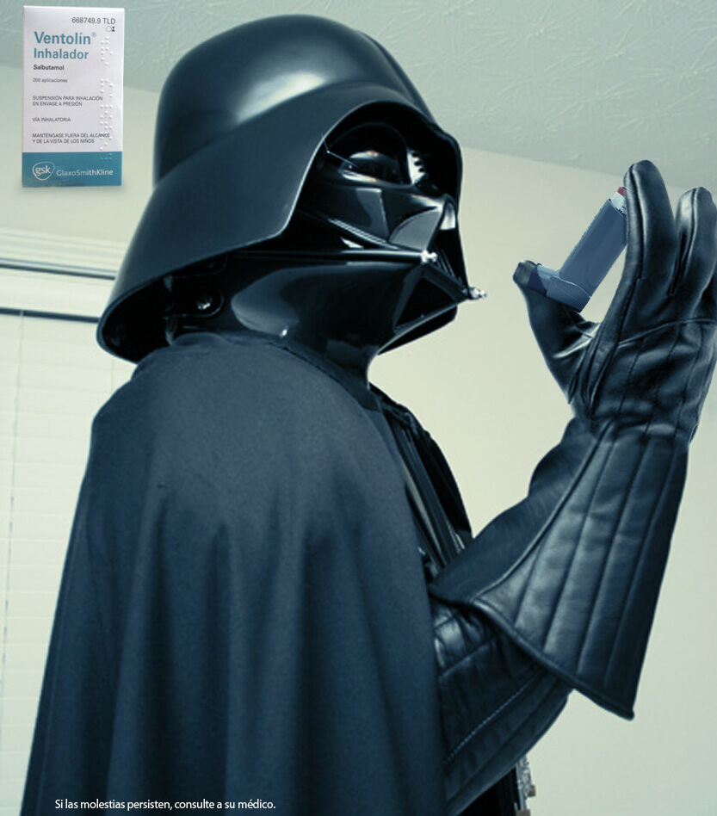
Case 3
15 year old male being treated for asthma attack in ED
Interpret each ABG
Has his condition improved?

Slide 27
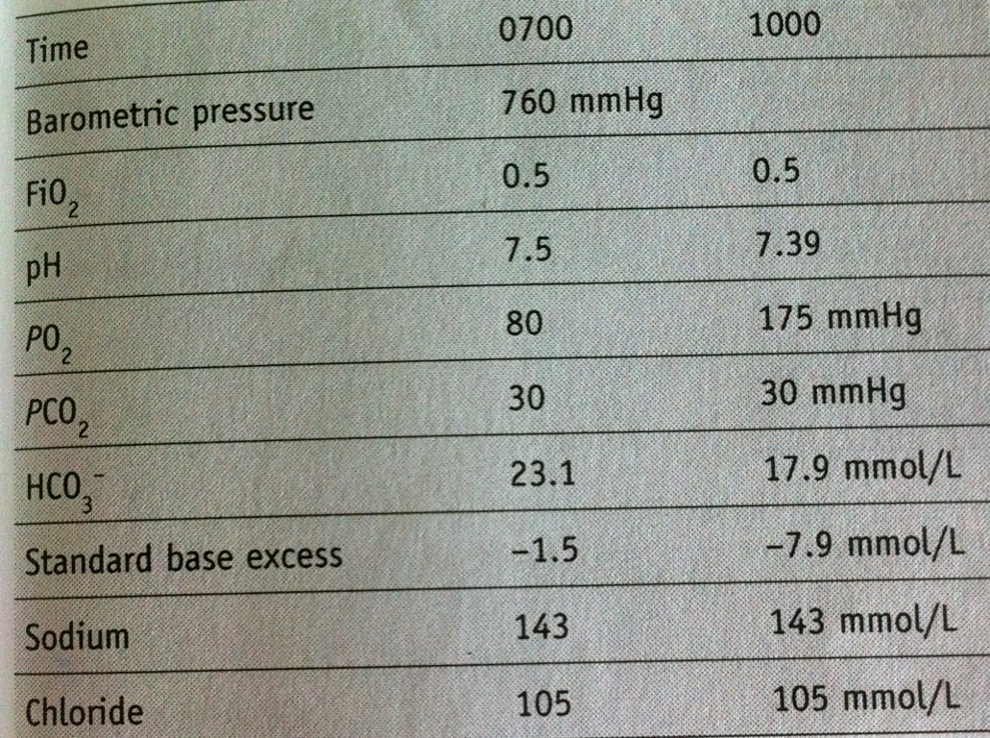

Slide 28
Case 3
0700:
Primary acute respiratory alkalosis
1000:
Dual disorder. Respiratory alkalosis and HAGMA

Slide 29
HAGMA
NAGMA
MAGMA

Slide 30
HAGMA

Slide 31
Carbon Monoxide
Alcoholic Ketoacidosis
Toluene
Methanol
Uraemia
DKA (Ketones)
Phenformin, Paracetamol, Pyroglutamic acidosis, Paraldehyde
Isoniazid
Lactate
Ethylene glycol, Ethanol
Salicylates

Slide 32
NAGMA
Addisons
Bicarbonate loss (GI or Renal)
Chloride gain
Drugs eg acetazolamide

Slide 33
MAGMA

Slide 34
Case 4
A 60 year old woman presents with pneumonia, shock and respiratory distress.
Interpret ABG

Slide 35
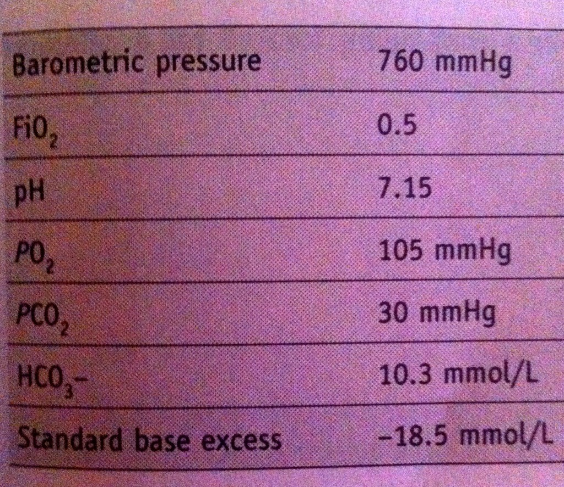

Slide 36
Case 4
Mixed acid base disorder
Severe metabolic acidosis
Co-existing Respiratory acidosis

Slide 37
Case 5
Patient admitted to ICU post pelvic exenteration for ovarian malignancy.
Interpret ABG.

Slide 38
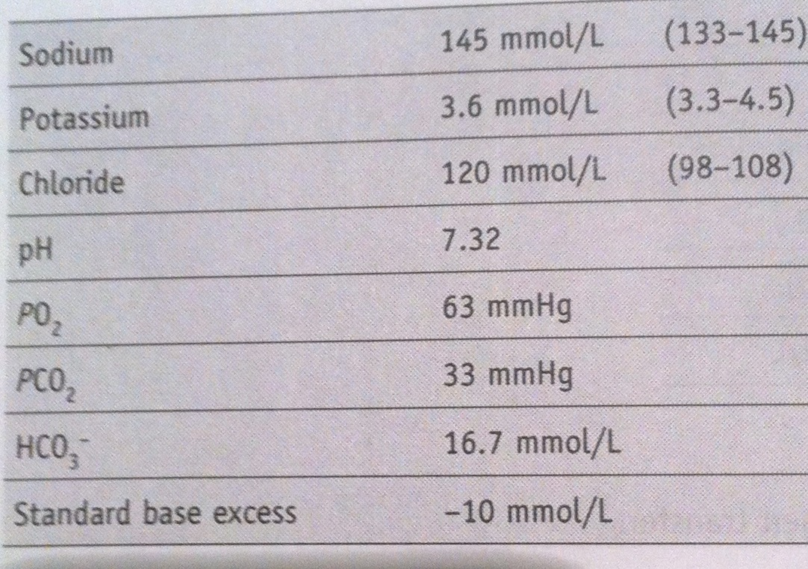

Slide 39
Case 5
NAGMA,
Hyper Cl-
Appropriate respiratory compensation

Slide 40
Case 6
Patient presents with severe DKA.
Eight hours after admission there is persistent acidaemia.
Interpret ABG

Slide 41
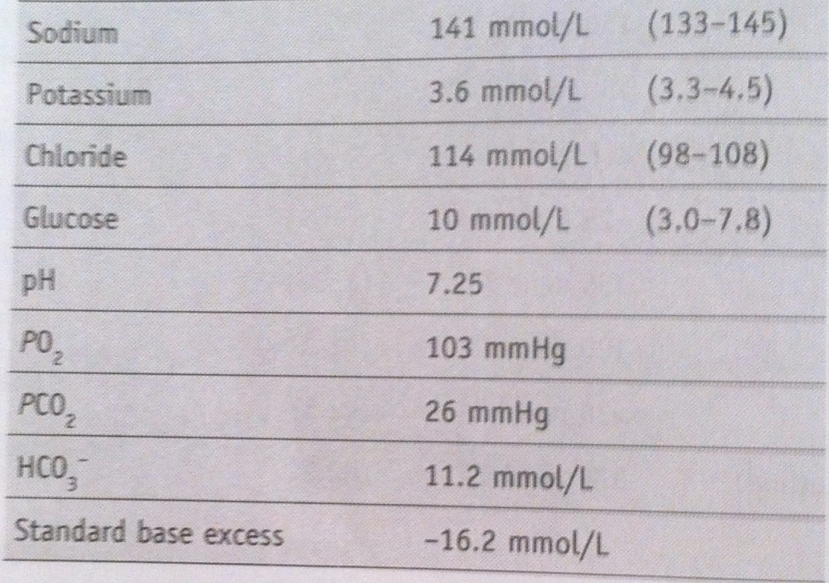

Slide 42
Case 6
Compensated metabolic acidosis
Likely persistent ketoacidosis in this setting

Slide 43
Case 7
73 year old lady with COPD awaiting cholecystectomy.
Anaesthetist called to do preop work up.
Interpret ABG

Slide 44
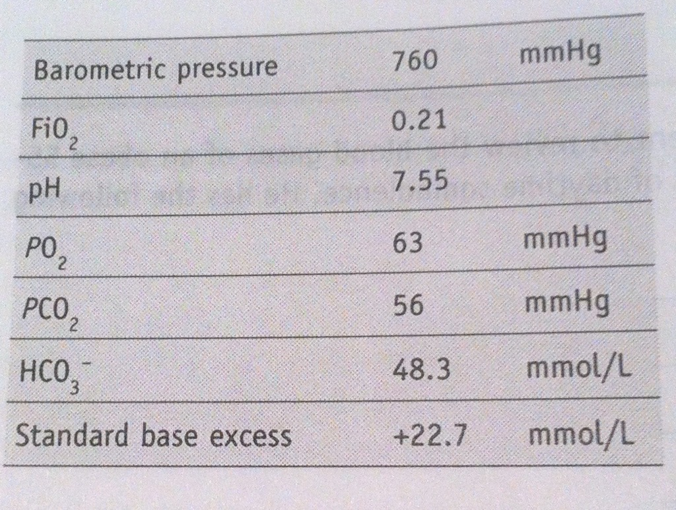

Slide 45
Case 7
Severe primary metabolic alkalosis
Appropriate respiratory compensation

Slide 47
Case 8
48 year old malnourished female with an eating disorder presents to ED and looks dehydrated

Slide 48
Labs
EUC:
Na 123
Cl 75
K 1.7
Mg 0.52
Phos 0.95
Urea 2.1
Alb 13
ABG:
pH 7.80
pCO2 38.3
HCO3 49
SBE >30

Slide 49
What was that about albumin and the gap?
AG + [(44 - albumin)/4]

Slide 50
Na:Cl ratio?
140mmol/L Na+ : 100mmol/L Cl-
Ratio =1.4 : 1 is NORMAL
123 Na : 75 Cl
1.64 : 1............. ALKALOSIS

Slide 52
Case 8
Chronic Metabolic Alkalosis
Concomitant Acute Resp Alkalosis
Why is she hyperventilating?
The GAP?

Slide 53
DELTA GAP
ANIONS
BICARB

Slide 55
DELTA GAP
<0.4 = Hyper Cl-
0.4 - 0.8 = Combo HAGMA & NAGMA or Renal acidosis
1 - 2 = Uncomplicated HAGMA eg DKA
>2 = Pre-existing MET ALKALOSIS or compensated Resp Acidosis prior to onset of MET ACIDOSIS

Slide 57
Case 9
42 year old male with history of codeine abuse but also previous IVDU and multiple admissions to rehab etc.
Presents unable to move after few days of vomiting
Long term constipation
Bradycardic with pauses on monitor

Slide 58
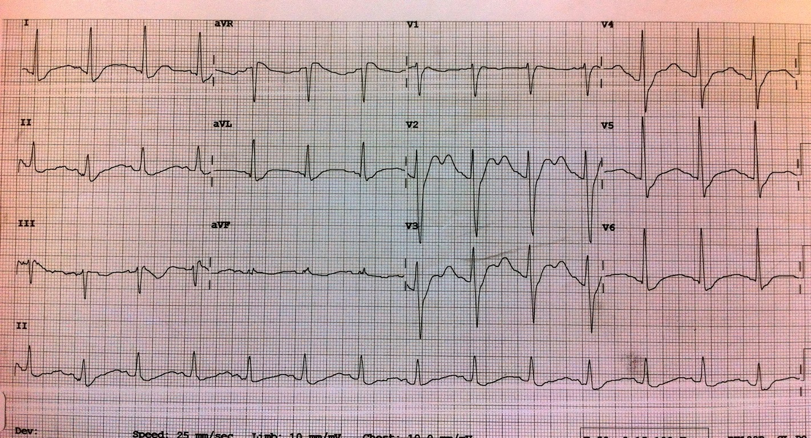

Slide 59
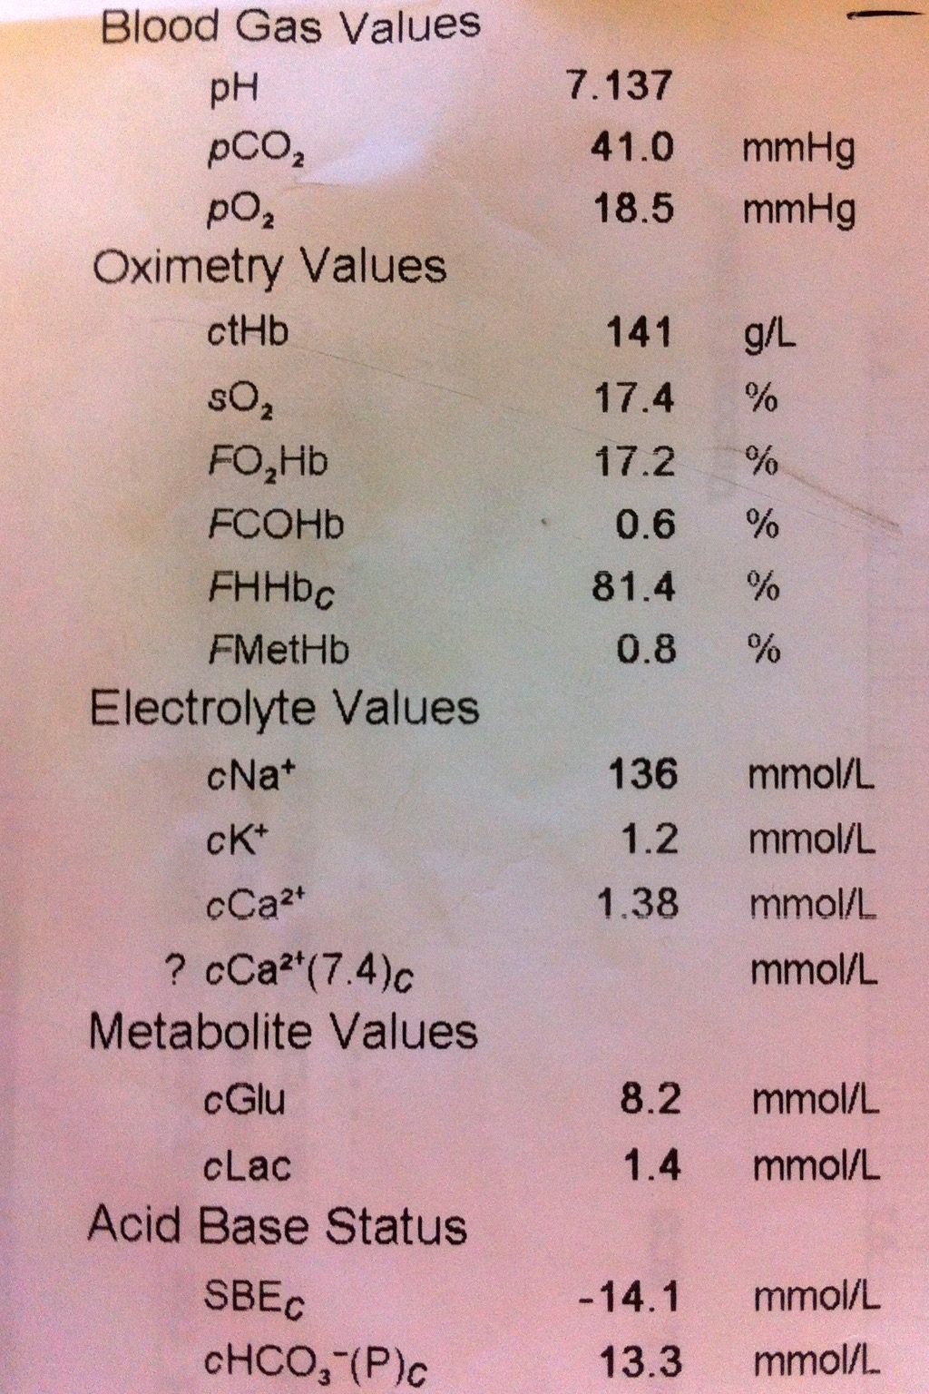
Cl- = 100

Slide 60
Case 9
Delta Gap = 0.747
Combo of HAGMA and NAGMA
RTA from NSAIDs = NAGMA
?Co-ingestion/?Sepsis for HAGMA
Lactate not elevated though

Slide 61
Case 10
54 year old male, known alcoholic presents weak and malnourished looking
Sometimes things just don't add up!

Slide 62
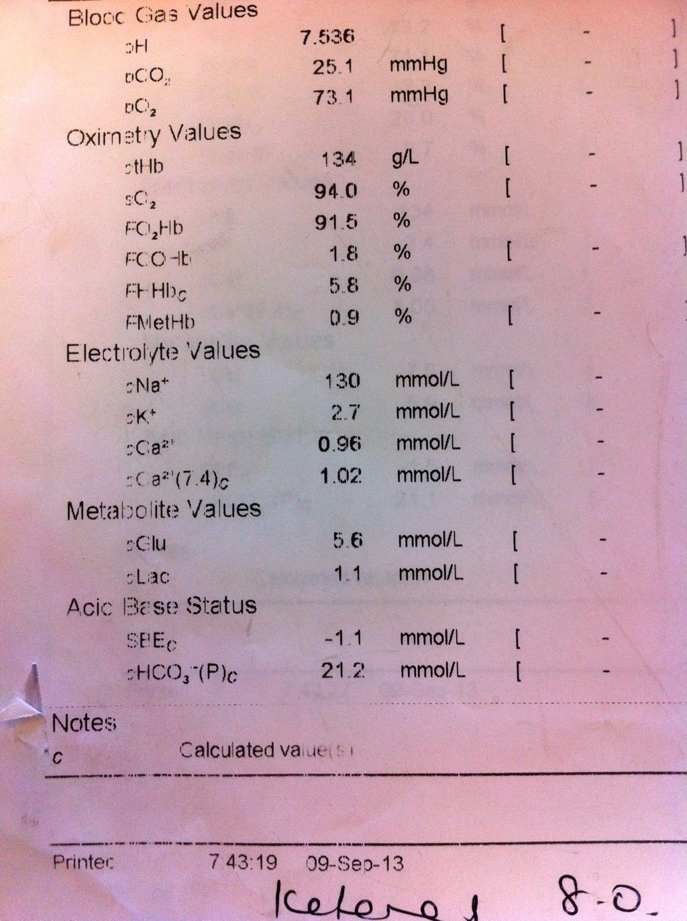
LABS
Na 131
K 2.6
Cl 92
Urea 3
Creat 72
AG 21
Alb 45

Slide 63
Case 10
Acute Resp ALKALOSIS
HAGMA
Delta 1.3
Combo alcoholic/keto-acidosis

Slide 64
